Slide 1
How Airline Delay Impacts Satisfaction
Analysis of
Groups Member:
Ge Zeng, Xiaoying(Shawn) Zou, Yufeng Xie, Xinyue Yu, Zirui Zhou

Slide 2
Contents
Analysis Outline
Data Source & Data Process
Problem Analysis
Limitation
Summary

Slide 3
Analysis Outline
What is the
Question?
How Airline Delay Impacts Satisfaction
Why is It
Important?
How to improve satisfaction rate for delay flight?
How do We
Solve it?
Dependent Variable:
Delay
Independent Variable:
Satisfaction
Step 1:
For all observations,
Whether delay impacts satisfaction &
Whether different delay periods have different impacts
Delay vs. No Delay
All Observations
Subgrouping
Short Period Delay
vs.
Mid Period Delay
vs.
Long Period Delay
Gender
Class
Step 2:
For subgroups,
Whether delay impacts satisfaction &
Whether different delay time have different impacts
Age
Flight Distance
Customers Type
Travel Type

Slide 4
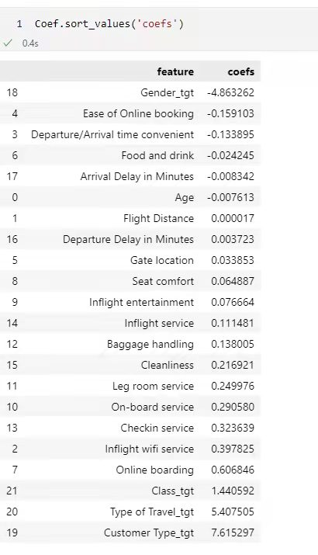
Data Source & Data Process
Delay Periods
Short
<= 30 minutes
Mid
30-90 minutes
Long
> 90 minutes
Data Source
Airlines Customer satisfaction | Kaggle
Subgrouping
Important Variables Meaning
Method: Logit Regression – Find the most related variables
Regression Coefficient:
Variables | Meaning
Satisfaction | Whether a customer is satisfied with the flight experience. Value: Satisfied & Not satisfied
Delay | Whether the flight is delay. Value: delay time, by minutes.
Gender | Value: Female & male
Customer type | Whether a customer is loyal customer. Value: Loyal & Disloyal
Type of travel | For customers, the purpose of this flight. Value: Business & Personal
Class | For customers, the class of this fight. Value: Business & Eco
Age | Integer Value.
Flight Distance | The flight distance of each flight. Value: distance, by kilometers.
Most Related:
Gender
Customer Type
Type of Travel
Class
Other interested:
Age
Flight Distance

Slide 5
Whether Delay has an impact on satisfaction for all passengers?
Generally, no delay group generates higher satisfaction rate. The Longer the delay, the lower the satisfaction rate.
Delay vs. No Delay
Short vs. Mid vs. Long Delay Time

Slide 6
Subgroup: Gender x Delay
The impact of delay on satisfaction does not depend on gender.
Gender: Delay vs. No Delay
Insight 2:
Male tend to be more satisfied with the flight than female
Insight 1:
The impact of delay on satisfaction does not depend on gender.
-5.68%
-5.78%

Slide 7
Subgroup: Gender x Delay
The impact of delay time on satisfaction is associated with gender.
Women would have higher tolerance for longer delay time.
Gender: Short vs. Mid vs. Long Delay Time
Male
Decline
Delay Time Increase
Decline
Increase
Satisfaction rate Decrease
Female
Delay Time Increase
Satisfaction rate Decrease
and then bounce up when delay exceeds 90 minutes

Slide 8
Subgroup: Age x Delay
The impact of delay on satisfaction depends on age.
Age: Difference of satisfaction for Delay and No Delay
The age group under 21 and over 60 would have a sharper drop in satisfaction level for delayed flight, suggesting more sensitivity to delay.
The 41-60 age bracket have a lower drop in satisfaction level for delayed flight, suggesting less sensitivity to delay.
Age: Delay vs. No Delay

Slide 9
Subgroup: Age x Delay
The impact of delay time on satisfaction is associated with age.
Age: Short vs. Mid vs. Long Delay Time
Insight:
Generally, people are less satisfied for longer delay.
But the satisfaction level of young people under 30 bounces up for longer delay time.
One potential justification is that airlines would compensate passengers for long-delayed flights, and young people are more receptive to these compensation.

Slide 10
Subgroup: Class x Delay
The impact of delay on satisfaction depends on class.
Class: Delay vs. No Delay
Insight 1:
Economy Plus passengers are more sensitive to delay compared to other classes.
4.67%
Insight 2:
Business class passengers have highest satisfaction level among all passengers.
10.05%

Slide 11
Subgroup: Class x Delay
The impact of delay time on satisfaction is associated with class.
Class: Short vs. Mid vs. Long Delay Time
Insight:
Generally, satisfaction level decreases as delay time increases.
But the satisfaction level of Economy Plus and Economy class bounces up, suggesting high sensitivity to compensation.
Business class are less sensitive to compensation.

Slide 12
Subgroup: Other x Delay
The impact of delay on satisfaction does not depend on flight distance, customer type and travel type.
Flight Distance
Customer Type
Travel Type
Among all subgroups divided by Flight Distance, Customer Type and Travel Type, the satisfaction rate declines as the delay time increases
Interpretation

Slide 13
Limitation
Ideal Dataset
Our Dataset
1. Abundant data & various type of variables
1.Most of variables are Binary
2. Randomly generated sample
2. Uncertainty of Randomization
Limitations
1. Dependent variable ‘Satisfaction’ is Binary:
I. Less statistical methodology to implement
II. Incapacity to research on the degree of satisfaction
III. Less interpretability on analysis
2. The distribution of of variable ‘Class’ suggests a suspicious pre-decided sampling:
For example, more than half of the sample comes from passengers on business class, suggesting data generating process may not be randomized.

Slide 14
Summary
Findings
Recommendation
Generally, delay has negative impact on passengers’ satisfaction, but different subgroups have different level of sensitivity.
Overall
For Eco and Eco Plus Class passengers, the airline companies could pay more attention to the compensation for longer delay as these passengers are more sensitive for compensation for delay.
Gender
Women are relatively more patient than men to endure longer delay.
For Business class passengers, the airline companies could focus more on elevating service quality for delayed flights as these passengers are less sensitive to compensation for delay.
Eco and Eco Plus Class are more sensitive to compensation for delay than Business class.
Class
The airline companies could provide more customized services for young and old customers such as giving out local souvenirs, providing food and snacks for children, offering convenient and fast WiFi services and updating notification in person for the elderly.
People under 21 and over 60 are more sensitive to delay, and people under 30 are more sensitive to compensation.
Age

Slide 15
Thank you for Listening!

